Slide 1
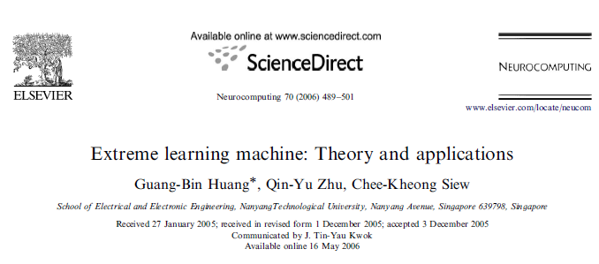
Extreme Learning Machine
Author: Manuel Montoya Catalá

Slide 2
Extreme Learning Machine
Introduction
ANN model
BP Algorithm
ELM Algorithm

Slide 3
Introduction
Extreme Learning Machine (ELM) is an algorithm for training neural networks with a single hidden layer and that are feedforward (SLFN).
It basically consists on:
Randomly choosing the parameters of the hidden neurons.
Analytically determine the parameters of the output neuron.
In this presentation I will introduce you to Neural Networks and then explain briefly two learning algorithms:
Back-Propagation algorithm
ELM algorithm

Slide 4
Extreme Learning Machine
Introduction
ANN model
BP Algorithm
ELM Algorithm

Slide 5


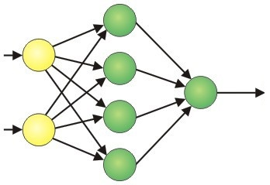
ANN Model
ANNs are processing systems that are
modeled after the structure of the brain.
Like the brain:
They consist of a group of processing units called Artificial Neurons.
These neurons are connected to each other, sharing information.
They work in common to perform a given task.

Slide 6


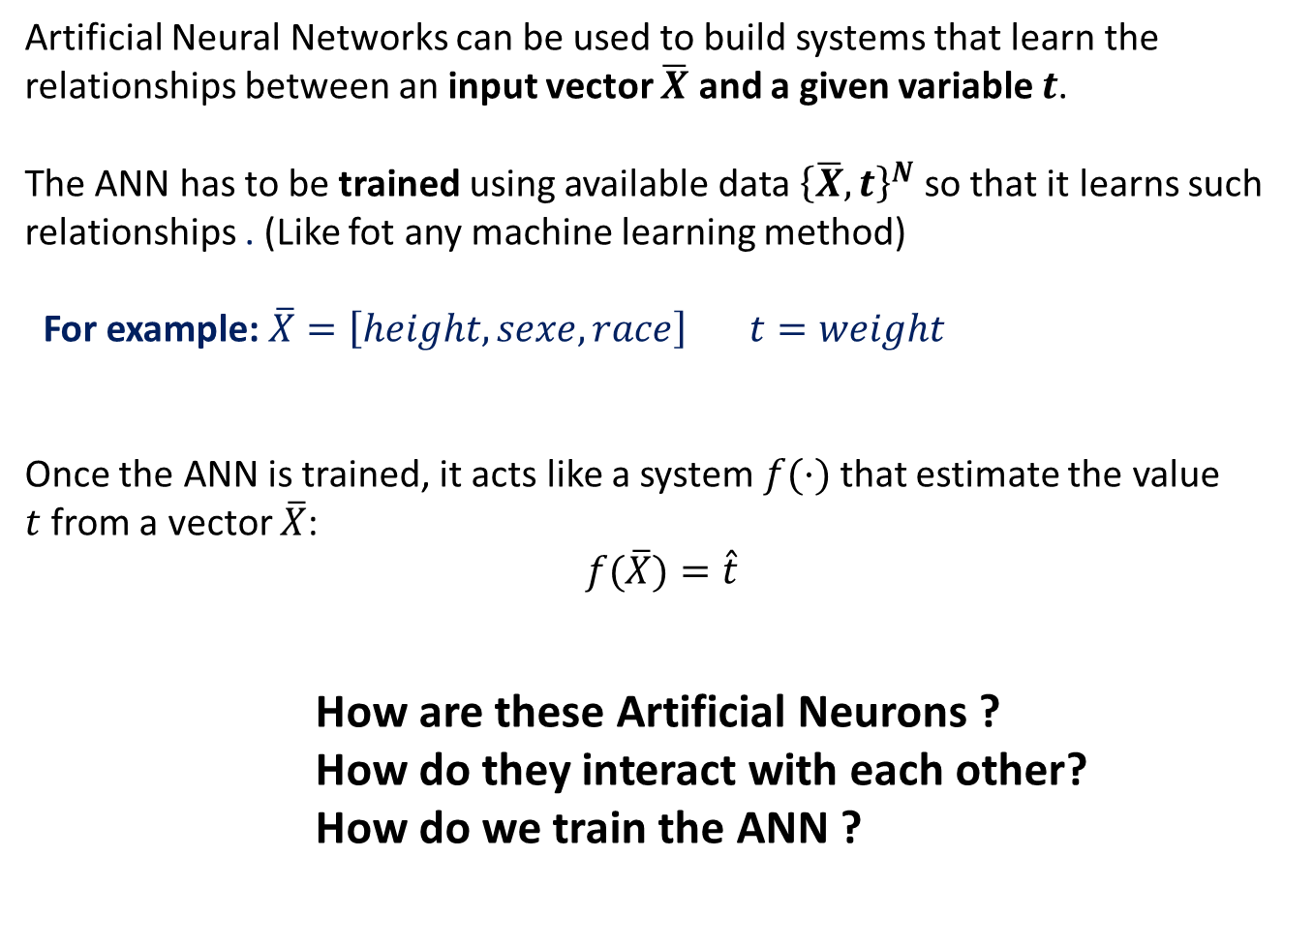
ANN Model
Artificial Neural Networks can be used to build systems that learn the relationships between an input vector $\overline{X}$ and a given variable $t$.
The ANN has to be trained using available data ${\left\{\overline{X},t\right\}}^{N}$ so that it learns such relationships . (Like fot any machine learning method)
For example: $\overline{X}=\left[height, sexe, race\right] t=weight$
Once the ANN is trained, it acts like a system$f(·)$that estimate the value $t$from a vector $\overline{X}$:
$$f(\overline{X})=\hat{t}$$
How are these Artificial Neurons ?
How do they interact with each other?
How do we train the ANN ?

Slide 7
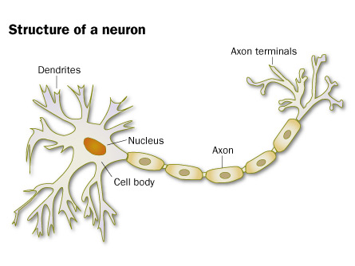
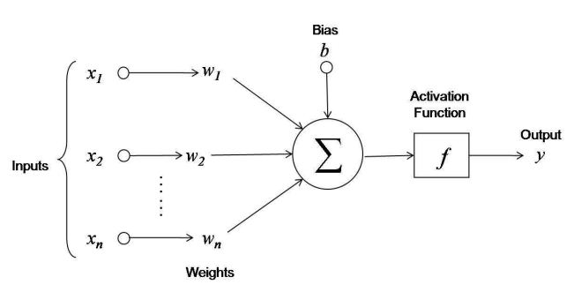
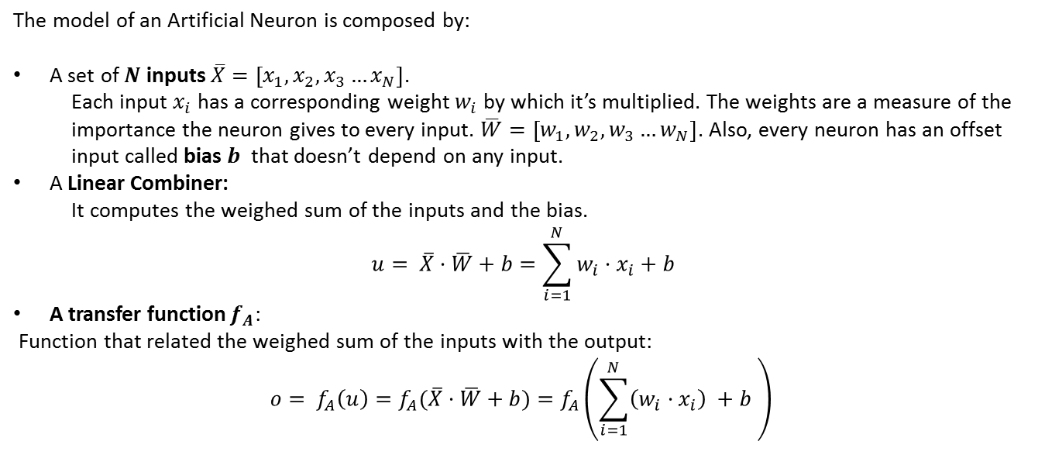
Neuron Model
The model of an Artificial Neuron is composed by:
A set of$N$ inputs $\overline{X}=\left[x_{1},x_{2},x_{3}…x_{N}\right]$.
Each input $x_{i}$ has a corresponding weight $w_{i}$ by which it’s multiplied. The weights are a measure of the importance the neuron gives to every input. $\overline{W}=\left[w_{1},w_{2},w_{3}…w_{N}\right]$. Also, every neuron has an offset input called bias $b$ that doesn’t depend on any input.
A Linear Combiner:
It computes the weighed sum of the inputs and the bias.
$$u= \overline{X}·\overline{W}+b=\sum_{i=1}^{N}{w_{i}·x_{i}+b}$$
A transfer function $f_{A}$:
Function that related the weighed sum of the inputs with the output:
$$o= f_{A}\left(u\right)=f_{A}(\overline{X}·\overline{W}+b)=f_{A}\left(\sum_{i=1}^{N}{\left(w_{i}·x_{i}\right)} +b \right)$$

Slide 8
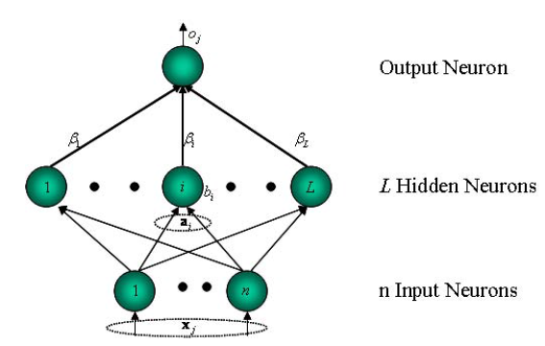
Architecture
The architecture of the ANN defines the number of artificial neurons it contains and the way they are interconnected. These connections define the dependences between the neurons and the ability of the ANN to learn.
Different architectures are more likely to learn different kinds of patterns.
Usually, neurons are grouped in layers: Layers are groups of neurons with the same model and same interconnection geometry.
A basic type of architecture is the SLFN architecture.
It consists of 3 layers:
Input layer
Hidden layer
Output layer
There are no loops:
The output of a neuron from a given layer is not the input of neuron of a previous one.

Slide 9
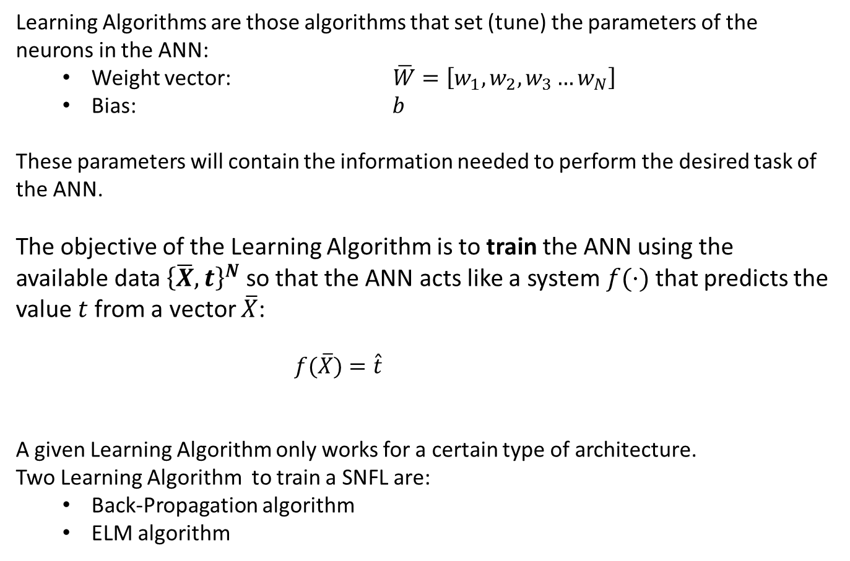
Learning Algorithm
Learning Algorithms are those algorithms that set (tune) the parameters of the neurons in the ANN:
Weight vector: $\overline{W}=\left[w_{1},w_{2},w_{3}…w_{N}\right]$
Bias: $b$
These parameters will contain the information needed to perform the desired task of the ANN.
The objective of the Learning Algorithm is to train the ANN using the available data ${\left\{\overline{X},t\right\}}^{N}$ so that the ANN acts like a system$f(·)$that predicts the value $t$from a vector $\overline{X}$:
$f(\overline{X})=\hat{t}$
A given Learning Algorithm only works for a certain type of architecture.
Two Learning Algorithm to train a SNFL are:
Back-Propagation algorithm
ELM algorithm

Slide 10
Extreme Learning Machine
Introduction
ANN model
BP Algorithm
ELM Algorithm

Slide 11
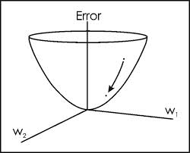

BP algorithm
The Back-Propagation algorithm is one the first training algorithms designed.
It is based on the fact that, given a training sample ${\left\{\overline{X},t\right\}}_{i}$
Any weight parameter value $w_{ij}$ of the ANN has a given effect on the error of the estimation and this effect can be calculated.
If we can calculate how the variation of any $w_{ij}$ will
affect the error, we could iteratively change the values
of $w_{ij}$so that we reduce this error:
By moving in the opposite direction of the gradient:
$\frac{∂Error}{∂w_{ij}}=f\left(X,W,b,f_{A}\right)$
The BP-algorithm iteratively changes the values of $w_{ij}$ in the opposite direction of the gradient.
Note:
The effect of the value of $w_{ij}$ on the error is different for every training sample ${\left\{\overline{X},t\right\}}_{i}$

Slide 12
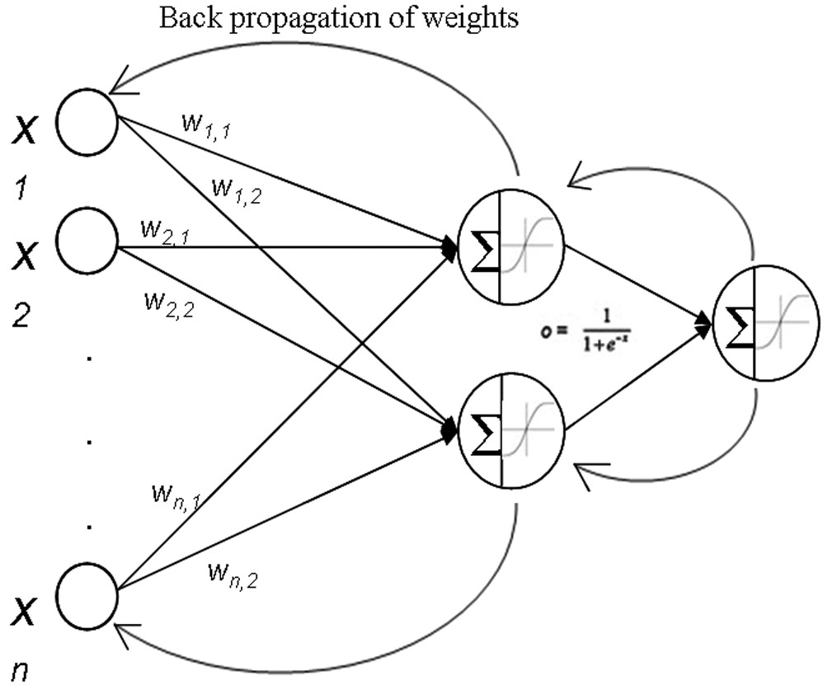
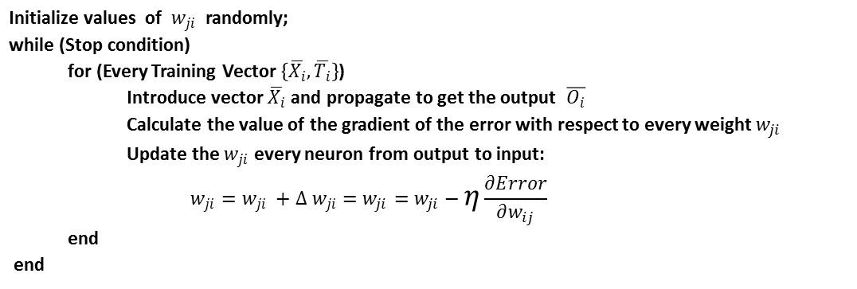

BP algorithm
The Pseudocode of the Back-Propagation algorithm is as follows
Initialize values of $w_{ji}$ randomly; while (Stop condition) for (Every Training Vector $\left\{\overline{X_{i}},\overline{T_{i}}\right\}$) Introduce vector $\overline{X_{i}}$ and propagate to get the output $\overline{O_{i}}$ Calculate the value of the gradient of the error with respect to every weight $w_{ji}$ Update the $w_{ji}$ every neuron from output to input: $$w_{ji}=w_{ji} +∆ w_{ji}=w_{ji}=w_{ji}−η\frac{∂Error}{∂w_{ij}}$$ end end
$η$: Is the learning rate of the algorithm.
Big values of this parameter will make the training to converge to quick and get stuck on local minima.
Small values will make the training too slow.

Slide 13
Extreme Learning Machine
Introduction
ANN model
BP Algorithm
ELM Algorithm

Slide 14

ELM algorithm
Extreme Learning Machine (ELM) is an algorithm for training feedforward neural networks with a single hidden (SLFN).
It basically consists on:
Randomly choose the parameters of the hidden nodes
Analytically determine the output weights of SLFNs
by just inverting a matrix
(Counter-Intuitive)
Specifications:
Normalize weights, bias and inputs.
The transfer function must be infinitely differentiable in any interval.
Characteristics:
Very fast !! The bottleneck is in the matrix inverse calculation.
Very resistant to overfitting.

Slide 15
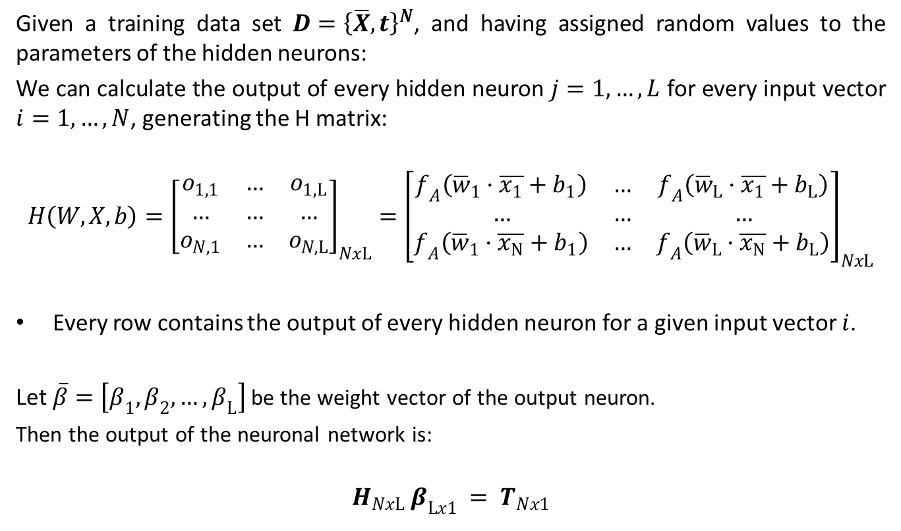
Maths of the ELM
Given a training data set ${D=\left\{\overline{X},t\right\}}^{N}$, and having assigned random values to the parameters of the hidden neurons:
We can calculate the output of every hidden neuron $j=1,…,L$ for every input vector $i=1,…,N$, generating the H matrix:
$$H\left(W,X,b\right)={\left[\begin{matrix}o_{1,1} & … & o_{1, L} \\ … & … & … \\ o_{N,1} & … & o_{N,L}\end{matrix}\right]}_{NxL}={\left[\begin{matrix}f_{A}\left({\overline{w}}_{1}·\overline{x_{1}}+b_{1}\right) & … & f_{A}\left({\overline{w}}_{L}·\overline{x_{1}}+b_{L}\right) \\ … & … & … \\ f_{A}\left({\overline{w}}_{1}·\overline{x_{N}}+b_{1}\right) & … & f_{A}\left({\overline{w}}_{L}·\overline{x_{N}}+b_{L}\right)\end{matrix}\right]}_{NxL}$$
Every row contains the output of every hidden neuron for a given input vector $i$.
Let $\overline{β}=\left[β_{1}, β_{2}, …, β_{L}\right]$ be the weight vector of the output neuron.
Then the output of the neuronal network is:
$$H_{NxL} β_{Lx1} = T_{Nx1}$$

Slide 16
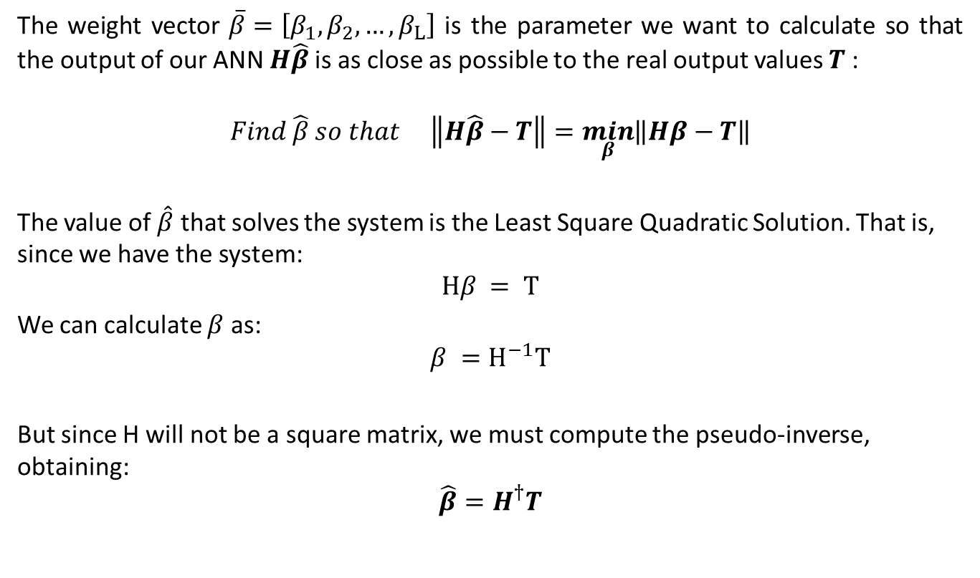
Maths of the ELM
The weight vector $\overline{β}=\left[β_{1}, β_{2}, …, β_{L}\right]$ is the parameter we want to calculate so that the output of our ANN $H\hat{β}$is as close as possible to the real output values $T$:
$$Find \hat{β} so that \left\|H\hat{β}−T\right\|=\min_{β}\left\|Hβ−T\right\|$$
The value of $\hat{β}$ that solves the system is the Least Square Quadratic Solution. That is, since we have the system:
$$Hβ = T$$
We can calculate $β$ as:
$$β =H^{−1}T$$
But since H will not be a square matrix, we must compute the pseudo-inverse, obtaining:
$$\hat{β}=H^{†}T$$

Slide 17
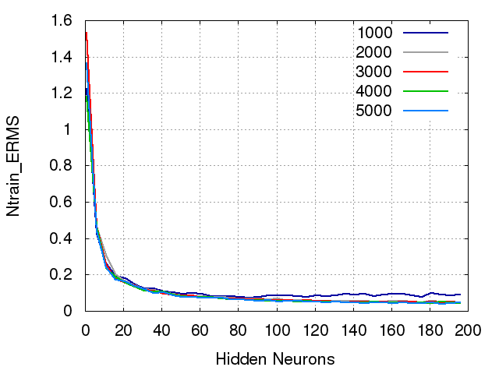
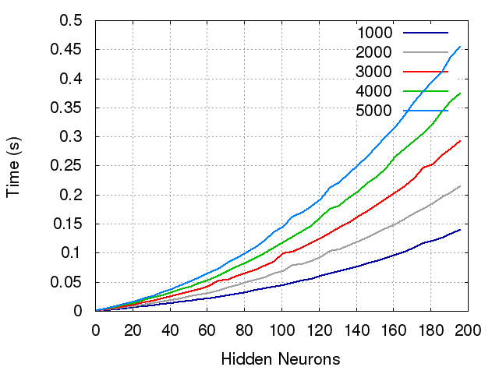
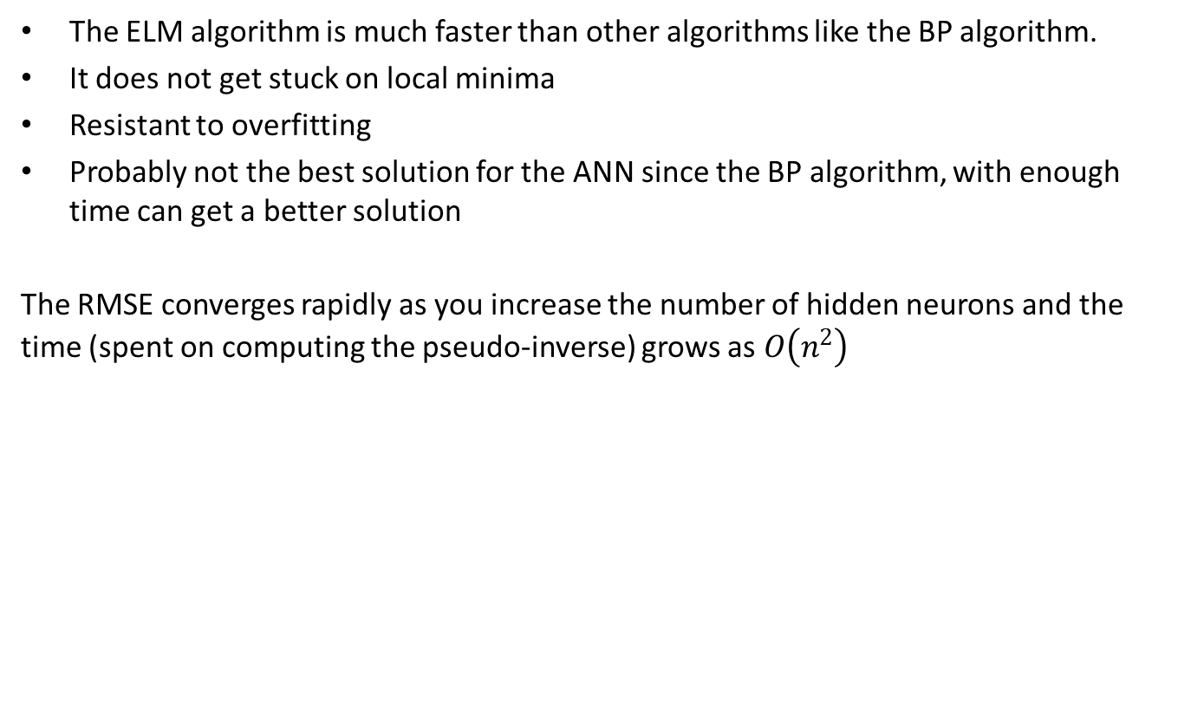
Performance of the ELM
The ELM algorithm is much faster than other algorithms like the BP algorithm.
It does not get stuck on local minima
Resistant to overfitting
Probably not the best solution for the ANN since the BP algorithm, with enough time can get a better solution
The RMSE converges rapidly as you increase the number of hidden neurons and the time (spent on computing the pseudo-inverse) grows as $O\left(n^{2}\right)$

Slide 18
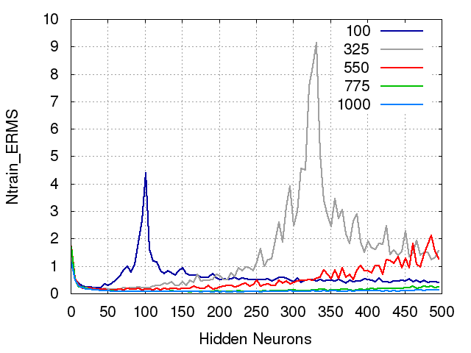
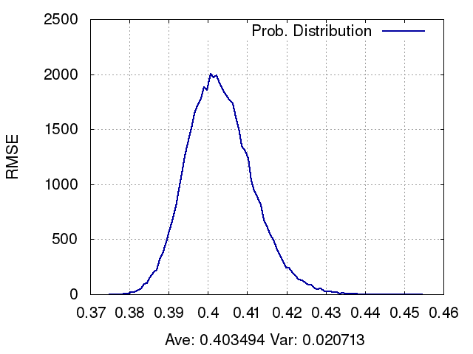
Performance of the ELM
If we increase a lot the number of hidden neurons
we get overfitting, which is maximized when the
number of neurons is the same as the number
of training vectors.
In this case, the model fits the training data.
Since the parameters of the hidden layer are chosen
randomly, the RMSE obtained for different executions
of the algorithm will differ. Performing the same
training several times we can estimate the probability
distribution of the RMSE.
The variance decreases as the average RMSE increases.

Slide 19
END

